Slide 1
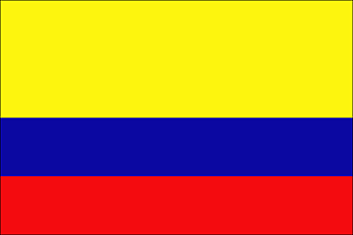
COLOMBIA

Slide 2
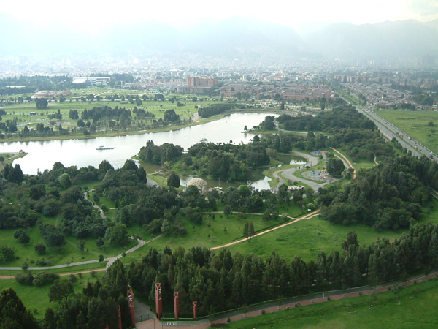
LOCATION
Colombia is surrounded by Panama, Venezuela, Brazil, Peru, and Ecuador. Though, Colombia only has road connections with Venezuela and Ecuador, these are a few of the easiest and most popular boarders to cross.
Bogota is the capital of Colombia.

Slide 3
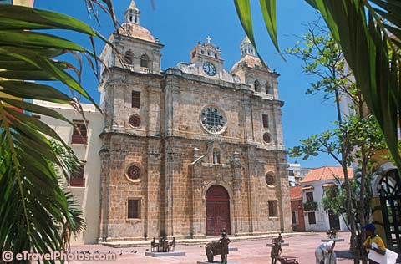
TOURIST ATTRACTIONS
“Graceful churches, excellent museums, cultural events and a thriving nightlife can keep you busy for several days. Bogotá is also the political, financial and service center for the country, and its geographic heart, making it a useful base from which to explore the country. Despite its massive sprawl, Bogotá is a dotted with parks and leisure spots. Cool air and almost daily rain sweep away residual pollution, and there are several high peaks to the east of town that help you to keep your perspective on the ground.”
Church in Colombia

Slide 4
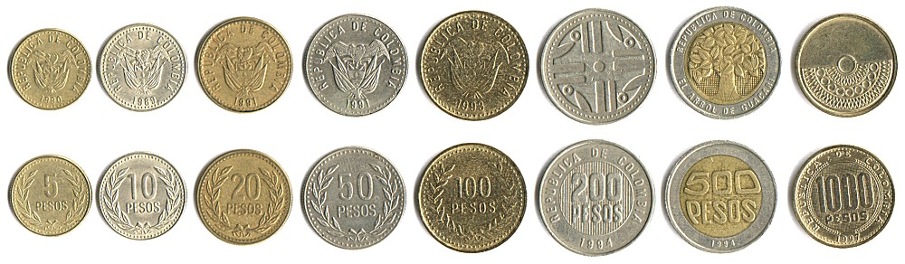
MONEY
Colombian money is pesos. If you have 1 peso then you have $0.000547 in U.S. money.
“Generally, Bancolombia and the Banco Unión Colombiano are the banks to visit if you need to change money or do any over-the-counter transactions. However, you will find half-a-dozen other banks in most medium-sized towns that have ATMs.”
Different amounts in pesos.

Slide 5
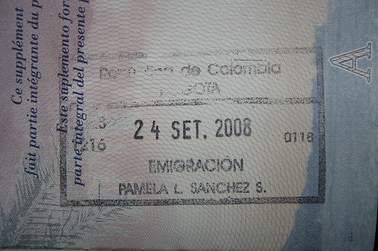
TRAVEL INFORMATION
“The maximum allowed is 90 days, but DAS officials often stamp 60 or just 30 days.”
“You are entitled to a 30-day extension (costing US$25), which can be obtained from DAS in any departmental capital. The new 30 days begins from the end of the visa already stamped in your passport (so there's no need to wait to the last minute). Most travelers apply for an extension in Bogotá.”
Travel stamp for Colombia.

Slide 6
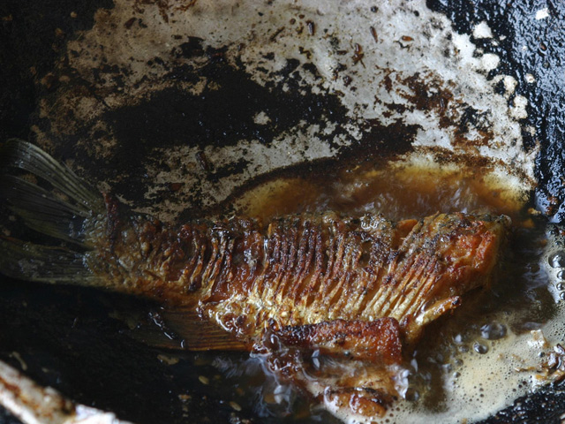
FOOD
“Guests are served first and given the largest portion of the dish.”
“Along the coasts, fish is a staple food. It is served boiled, baked, or fried. The meal is often rounded out with fried plantains and rice with coconut.”
Fried fish in Colombia.

Slide 7
SIMILARITIES
In both the U.S and Colombia some people go to church.
Colombia and the U.S both have a variety of fish to eat.
In Colombia they have lots of salsas and in the U.S that is one of the most popular foods.
In Colombia they wear light colors and in the US we do too. While we also have a variety of other clothing colors.
Also in Colombia they eat lots of soups and in the U.S. we eat a lot of soups too.

Slide 8
DIFFERENCES
We do not have limits on how long you can stay here, but Colombia has limits.
“The U.S. is a country of immigrants and Colombia is not.”
Colombia’s climate is very mild, but the U.S. has a variety of climates.
Most if not all of Colombia speaks Spanish, while most of the U.S. speaks English.
Clothing is very different too, in Colombia people dress by what the weather is doing, while in the U.S. people have a very different variety of clothing styles.

Slide 9
FAST FACTS
“Colombia's population of about 45 million is growing at 1.4 percent annually.”
“In Colombia, clothing is conservative, clean, and well kept. Appropriate attire for each occasion is essential. In urban areas, men wear suits, white shirts, and ties. In cities nearer the coast, suits generally are lighter in color. Women often wear comfortable dresses, and young people in urban areas dress casually. Dress in rural areas is less fashionable, but the people wear neat, clean clothing. Indigenous peoples often wear traditional clothing, which can include wraparound dresses, bowler hats, and ponchos.”
“While Colombia's constitution guarantees freedom of religion, nearly 90 percent of the people belong to the Roman Catholic Church.”
Many consider it important to keep hands above the table. In a group, it is impolite to take anything to eat without first offering it to others. Eating on the street is improper. Tipping is not mandatory in restaurants, but some people leave a tip of about 10 percent.
“Colombia is about the size of California and Texas combined.”

Slide 10
Citations
Getting there & away. 2009 9 October 2009 <http://www.lonelyplanet.com/colombia/transport/getting-there-away>.
Introducing Bogota. 2009 9 October 2009 <http://www.lonelyplanet.com/colombia/bogota>.
Money & costs. 2009 9 October 2009 <http://www.lonelyplanet.com/colombia/practical-information/money-costs>.
Visias. 2009 9 October 2009 <http://www.lonelyplanet.com/colombia/practical-information/visas>.
Colombia. 2009 14 October 2009 <http://online.culturegrams.com/world/world_country_sections.php?contid=7&wmn=South_America&cid=35&cn=Colombia&sname=Population&snid=3>.
Personal Appearance. 2009 14 October 2009 <http://online.culturegrams.com/world/world_country_sections.php?contid=7&wmn=South_America&cid=35&cn=Colombia&sname=Personal_Appearance&snid=7>.
Religion. 2009 14 October 2009 <http://online.culturegrams.com/world/world_country_sections.php?contid=7&wmn=South_America&cid=35&cn=Colombia&sname=Religion&snid=5>.
Eating. 2009 14 October 2009 <http://online.culturegrams.com/world/world_country_sections.php?contid=7&wmn=South_America&cid=35&cn=Colombia&sname=Eating&snid=10>.
Land and Climate. 2009 14 October 2009 <http://online.culturegrams.com/world/world_country_sections.php?contid=7&wmn=South_America&cid=35&cn=Colombia&sname=Land_and_Climate&snid=1>.
15 October 2009 <http://www.33ff.com/flags/XL_flags/Colombia_flag.gif>.
15 October 2009 <http://www.worldsbestlanguageschools.com/Bogota_Colombia.jpg>.
15 October 2009 <http://www.etravelphotos.com/photos/2003la/2003la-074-18s-w.jpg>.
15 October 2009 <http://farm4.static.flickr.com/3235/3016589460_fd085ec1af.jpg>.

