Slide 1

Paraguay

Slide 2
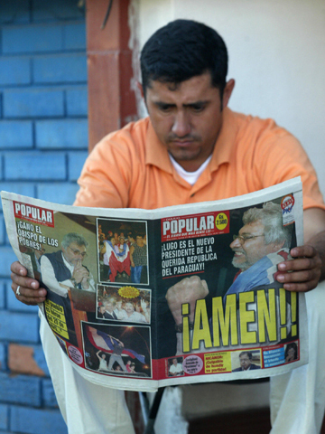
a normal morning
Even in Asuncion people like to read the newspaper in the morning only he is sitting on his outdoor steps

Slide 3
Food
These are the 5 main recipes
“Bori – bori”
“Empanadas”
“sopa paraguaya”
Winter Squash Soup
Cheesy Corn Bread

Slide 4
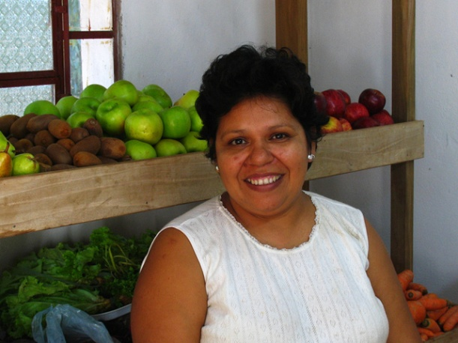
A lady that is selling fruits and vegetables on her little stand in Paraguay.

Slide 5
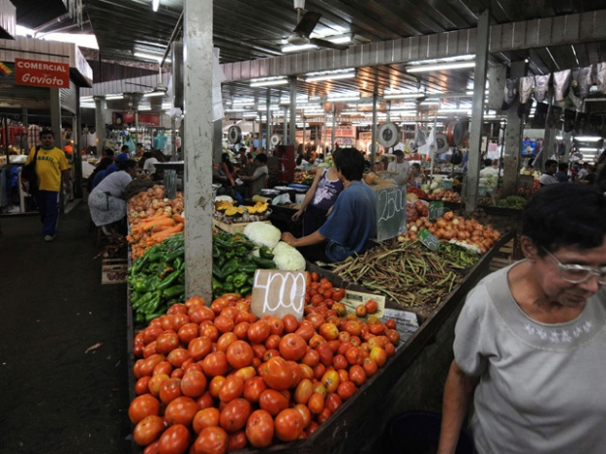
This is where most of Paraguay’s population does there shopping here at the Mercado. The Mercado is just like are grocery store. Paraguay has 5 main recipes these recipes are main dish bori-bori, empanadas, sopa Paraguay, and winter squash soup. Those are the 5 main dish recipes there are tons more but these are the main 5.

Slide 6
Family
“Three to four generations of one family might live in the same house or farm.”
“Most children are well behaved and polite.”
The father is the is the head of the family or the provider and the mother takes care of the household and children.

Slide 7
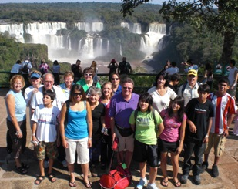
Family
These family can get really big as you can see in the picture

Slide 8
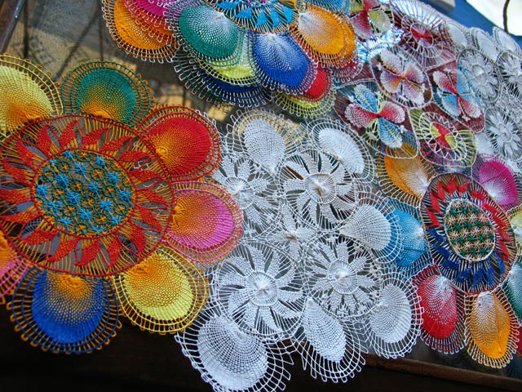
Tourist Attractions
This is the Nanduti which means spider web.
This is a very colorful piece of art

Slide 9
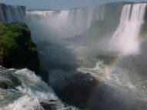
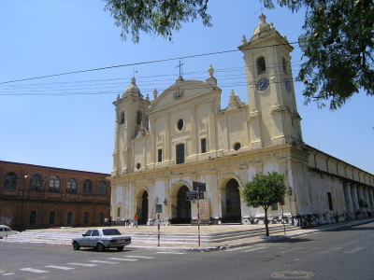
Tourist attractions
This is one of many tourist attractions

Slide 10
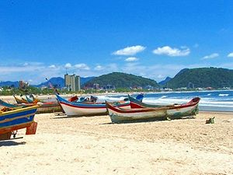
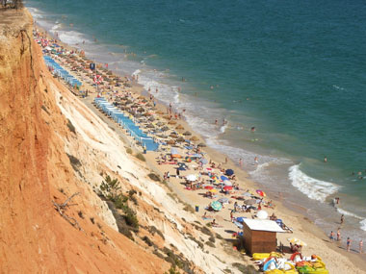
Beaches
This is a September beach

Slide 11

Health
They have doctors and clinics.
They also have some traveling doctors.

Slide 12
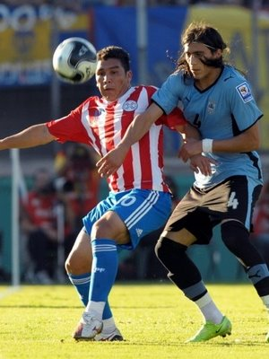
Similarities between Paraguay and the united states
In both states we play soccer.

Slide 13
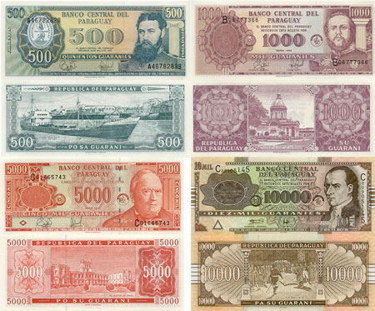
Currency
The currency of Paraguay is Guaraní

Slide 14
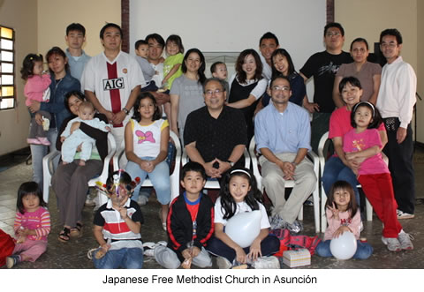
Education system

Slide 15
Citations
http://www.lonelyplanet.com/paraguay
Ñandutí. 2007. Photograph. Collection of CultureGrams. ProQuest, 2009. Web. 22 Oct 2009.
google. 16 oct 2009 <http://www.adoptivefamilytravel.com/Library/becca/paraguay%20families%20at%20falls%20309%20by%20245.jpg>.

