Slide 1
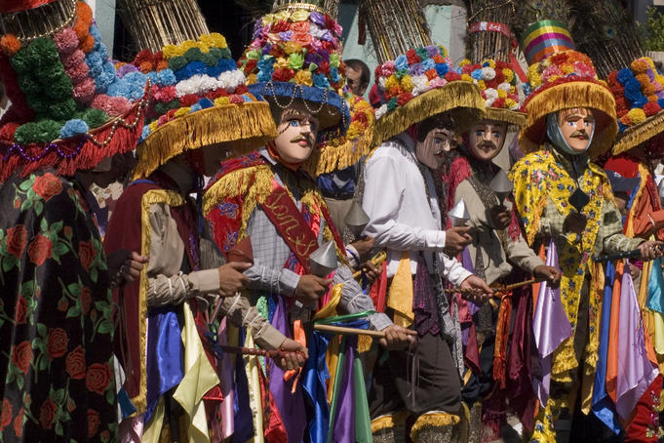
Most Nicaraguans are of both European and indigenous ancestry, and the culture of the country reflects the Ibero-European and indigenous heritage of its people. Only the indigenous of the eastern half of the country remain ethnically distinct and retain tribal customs and languages. A large black minority, of Afro-Caribbean origin, is concentrated on the Caribbean coast. In the mid-1980s, the central government divided the eastern half of the country--the former department of Zelaya--into two autonomous regions and granted the people of the region limited self-rule. Roman Catholicism is the major religion, but Evangelical Protestant groups have grown recently, and there are strong Anglican and Moravian communities on the Caribbean coast. Most Nicaraguans live in the Pacific lo and the adjacent interior highlands. The population is 58% urban
FAMILY

Slide 2
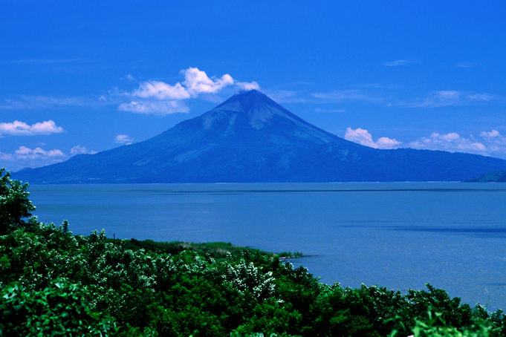
TOURIST ATTRACTIONS
Nicaragua has widespread underemployment and the second lowest per capita income in the Western Hemisphere. The US-Central America Free Trade Agreement (CAFTA) has been in effect since April 2006 and has expanded export opportunities for many agricultural and manufactured goods. Textiles and apparel account for nearly 60% of Nicaragua's exports, but recent increases in the minimum wage will likely erode its comparative advantage in this industry. Nicaragua relies on international economic assistance to meet internal- and external-debt financing obligations. In early 2004, Nicaragua secured some $4.5 billion in foreign debt reduction under the Heavily Indebted Poor Countries (HIPC) initiative, and in October 2007, the IMF approved a new poverty reduction and growth facility (PRGF) program. However, severe budget shortfalls resulting from the suspension of large amounts of direct budget support from foreign donors concerned with recent political developments has caused a slowdown in PRGF disbursements. Similarly, private sector concerns surrounding ORTEGA's handling of economic issues have dampened investment. Economic growth has slowed in 2009, due to decreased export demand from the US and Central American markets, lower commodity prices for key agricultural exports, and low remittance growth - remittances are

Slide 3
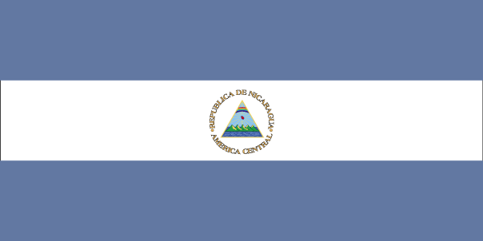
5 facts
· Nicaragua is the largest country in Central America.
· One points by extending the chin or puckering the lips in the intended direction.
· The national instrument is the marimba (which is similar to a xylophone)
and is usually accompanied by guitars, maracas, and traditional flutes (zuls).
· Nicaragua was named after Nicarao, the leader of one of the area’s early indigenous groups.
His name was combined with the Spanish word for water, agua, to form the word Nicaragua.

Slide 4
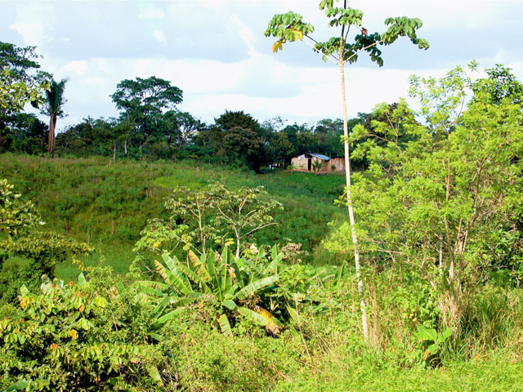
Natural resources
Yucca and beans are grown on this finca (farm). Although it is the largest country in Central America,
only about 20 percent of Nicaragua's land is suitable for cultivation. Still, almost half
of Nicaraguans make their living in agriculture. (Mulukuku, Nicaragua, February 2007)

Slide 5
Bibliography
Information:
"Nicaragua." CultureGrams Online Edition. ProQuest, 2009. Web. 21 Oct 2009.
Images:
Flag of Nicaragua." Image. CultureGrams Online Edition. ProQuest, 2009. Web. 21 Oct 2009
Finca. 2007. Photograph. Collection of CultureGrams. ProQuest, 2009. Web. 21 Oct 2009

